Slide 1
Error Propagation Wrap-Up
(53.6 ± 0.2) x (14.42 ± 0.02)
(12.8 ± 4%) + (3.45 ± 0.5%)

Slide 2
(53.6 ± 0.2) x (14.42 ± 0.02)
(53.6 ± 0.2) → 53.6 ± 0.4%
(14.42 ± 0.02) → 14.42 ± 0.1%
(53.6 ± 0.4%) x (14.42 ± 0.1%)
772.912 ± 0.5%
773 ± 0.5%
773 ± 4

Slide 3
(12.8 ± 4%) + (3.45 ± 0.5%)
(12.8 ± 4%) → 12.8 ± 0.5
(3.45 ± 0.5%) → 3.45 ± 0.02
(12.8 ± 0.5) + (3.45 ± 0.02)
16.25 ± 0.52
16.2 ± 0.5
16.2 ± 3%

Slide 4
Graphical Analysis
Graph the following data
Identify the relationship
Verify and determine the exact relationship
X | Y
0 | 0.0
2 | 7.1
4 | 10.0
6 | 12.2
8 | 14.1
10 | 15.8

Slide 5
Graphical Analysis
X | Y
0 | 0.0
2 | 7.1
4 | 10.0
6 | 12.2
8 | 14.1
10 | 15.8

Slide 6
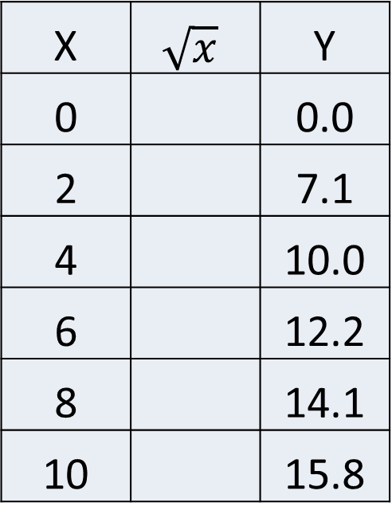

Graphical Analysis
To verify the relation, calculate $\sqrt{x}$
Graph Y vs. $\sqrt{x}$
Find the slope of the graph.
X | $$\sqrt{x}$$ | Y
0 |  | 0.0
2 |  | 7.1
4 |  | 10.0
6 |  | 12.2
8 |  | 14.1
10 |  | 15.8

Slide 7
Graphical Analysis

